Slide 1

Digital approaches to cross-border marketing and distribution of funds.

Slide 2


AGENDA
Background of EU Market
Existing policies
EU Consultations
Purpose of new policies
Examples & How we help
Questions

Slide 3

EU Market
UCITS funds account for 75% of collective investments used by small investors in Europe.
70% of Europe’s AUM are held in Funds that are only registered for sale in their domestic market.
Only 37% of UCITS and 3% of Alternative Investment Funds (AIF) are registered for sale in 3+ European countries*
The US market remains larger in terms of AUM:
United States Total AUM = $ 37.4 Trillion
EU Total AUM = $ 23.1 Trillion
What does this mean?
Notes:
*SOURCE: (12th March 2018) Proposal for a DIRECTIVE OF THE EUROPEAN PARLIAMENT AND OF THE COUNCIL - (European Commission)

Slide 4
Existing Policies
In 2009 and 2011, there were 2 directives introduced (2009/65/EC & 2011/61/EU), which outlined certain rules for cross-border distribution of funds.
What is Article 92?
Firms were required to take the necessary measures to ensure they have the facilities available for areas such as:
Set up and authorization aligned with the local laws (most states required physical presence).
The disclosure and reporting requirements of the UCITS
Fund managers were able to sell their funds in another country, provided they establish a physical presence in that country – a provision called ‘gold-plating’.
Notes:
Article 91: Member States shall ensure that complete information on the laws, regulations and administrative provisions which do not fall within the field governed by this Directive and which are specifically relevant to the arrangements made for the marketing of units of UCITS, established in another Member State within their territories, is easily accessible from a distance and by electronic means. Member States shall ensure that that information is available in a language customary in the sphere of international finance, is provided in a clear and unambiguous manner and is kept up to date.
Article 92: UCITS shall, in accordance with the laws, regulations and administrative provisions in force in the Member State where their units are marketed, take the measures necessary to ensure that facilities are available in that Member State for making payments to unit-holders, repurchasing or redeeming units and making available the information which UCITS are required to provide.

Slide 5
EU Consultations
The EU’s ultimate plan is to strengthen their economies to stimulate investment and create more jobs. For this, they need to emphasize a single market and remove barriers to people and investments.
'Gold-Plating’ was later identified to be a burden for fund managers and unclear on how they can distribute funds.
In 2015, they ran 2 consultations with stakeholders across the industry:
Green Paper on Capital Markets Union
Call for Evidence on the EU Regulatory framework
The European Commission also ran a roadshow across Member States.
The result: 64 responses total with the majority indicating that regulatory barriers were a significant disincentive to cross-border distribution.
Catering for these barrier’s costs between 1 and 4 percent of the overall expenses of an investment fund according to a questionnaire in May 2017.
Notes:
*SOURCE: (12th March 2018) Proposal for a DIRECTIVE OF THE EUROPEAN PARLIAMENT AND OF THE COUNCIL - (European Commission)

Slide 6
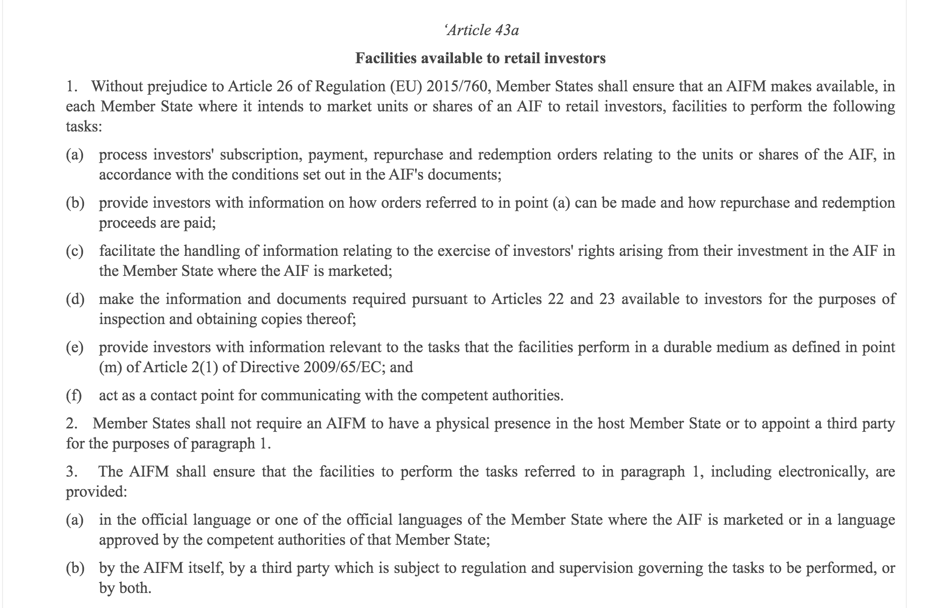
Purpose of new policies.
1. Responses suggested that regulatory barriers prevented the EU market from reaching its full potential as a single market of scale and economic strength.
2. As such, Article 92 will no longer be obligatory. From July 2021, Member States will not need to have local facilities in other Member States where they wish to promote UCITS.
3. Fund managers will be able to use digital or other means of distance communication with investors i.e. documentation, complaints, subscriptions, making or redeeming payments.
4. All of this is subject to the condition that the information and means of communication should be available to investors in the official languages of the Member State where the investor is located.
5. Other additional provisions include a precise time frame that must be met for any updates/changes to UCITS funds.

Slide 7

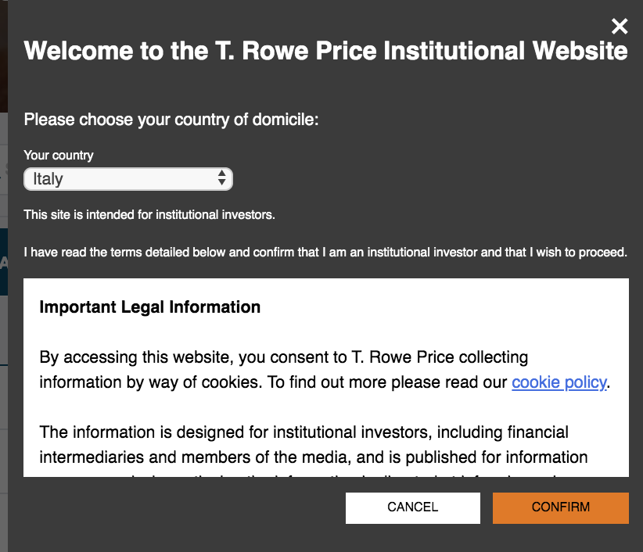
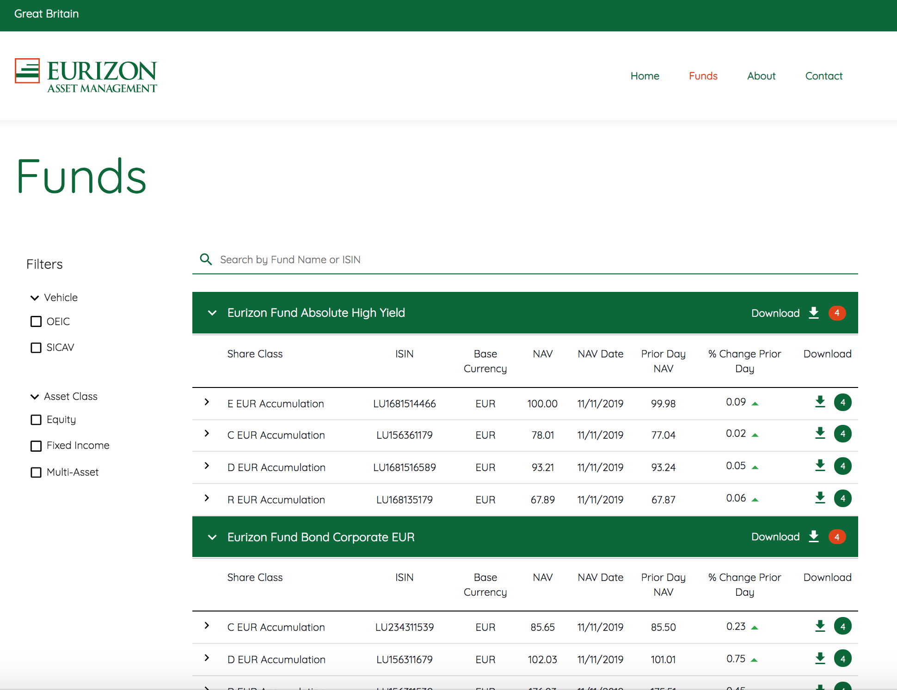
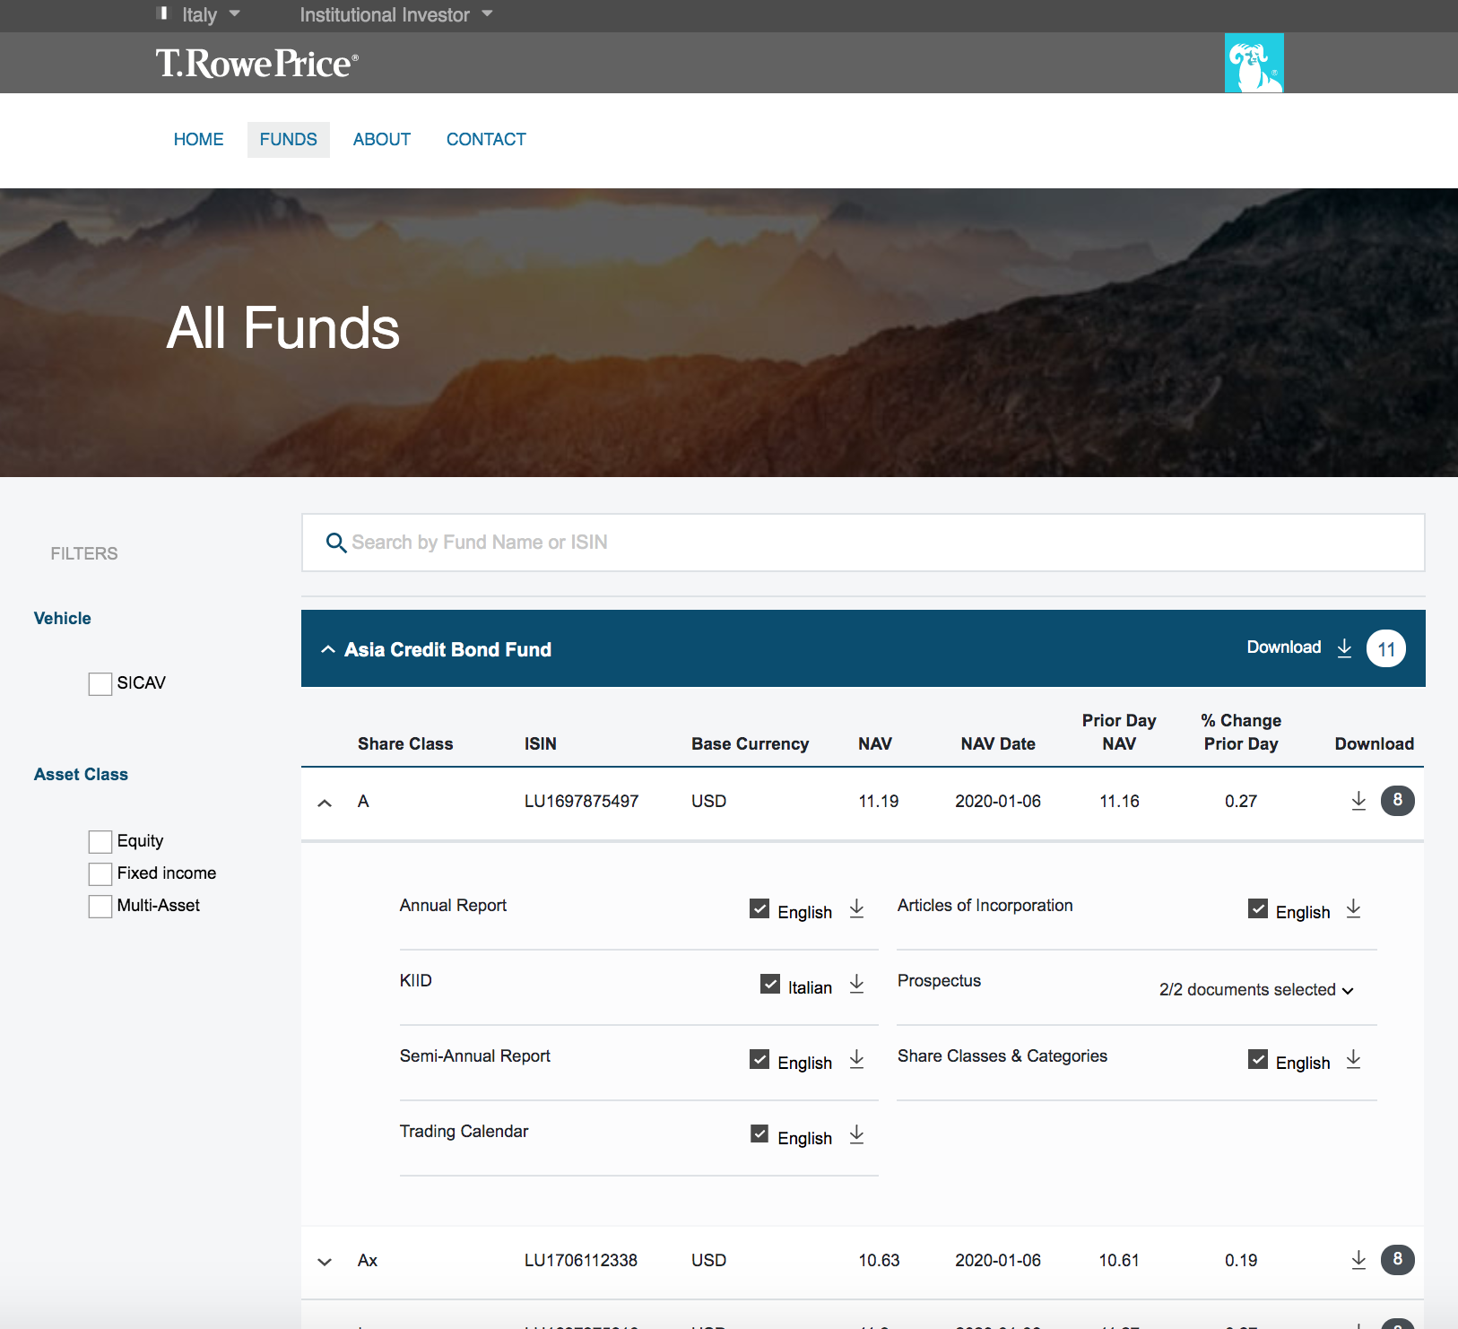
How we help

Slide 8
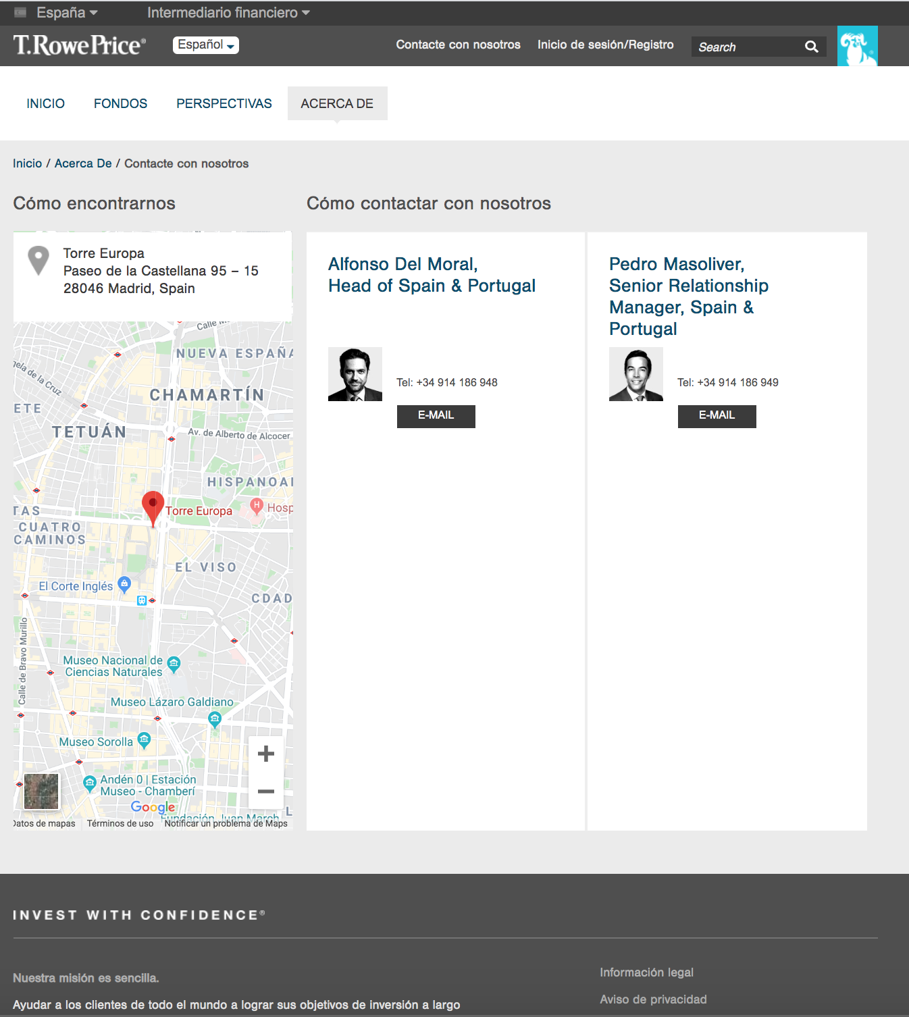
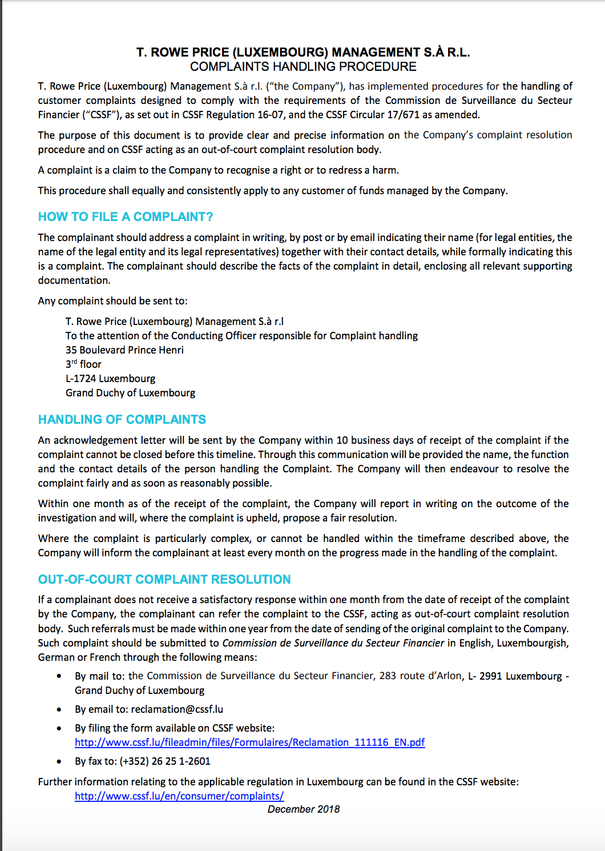
Local languages
Complaint Handling
Documentation

Slide 9
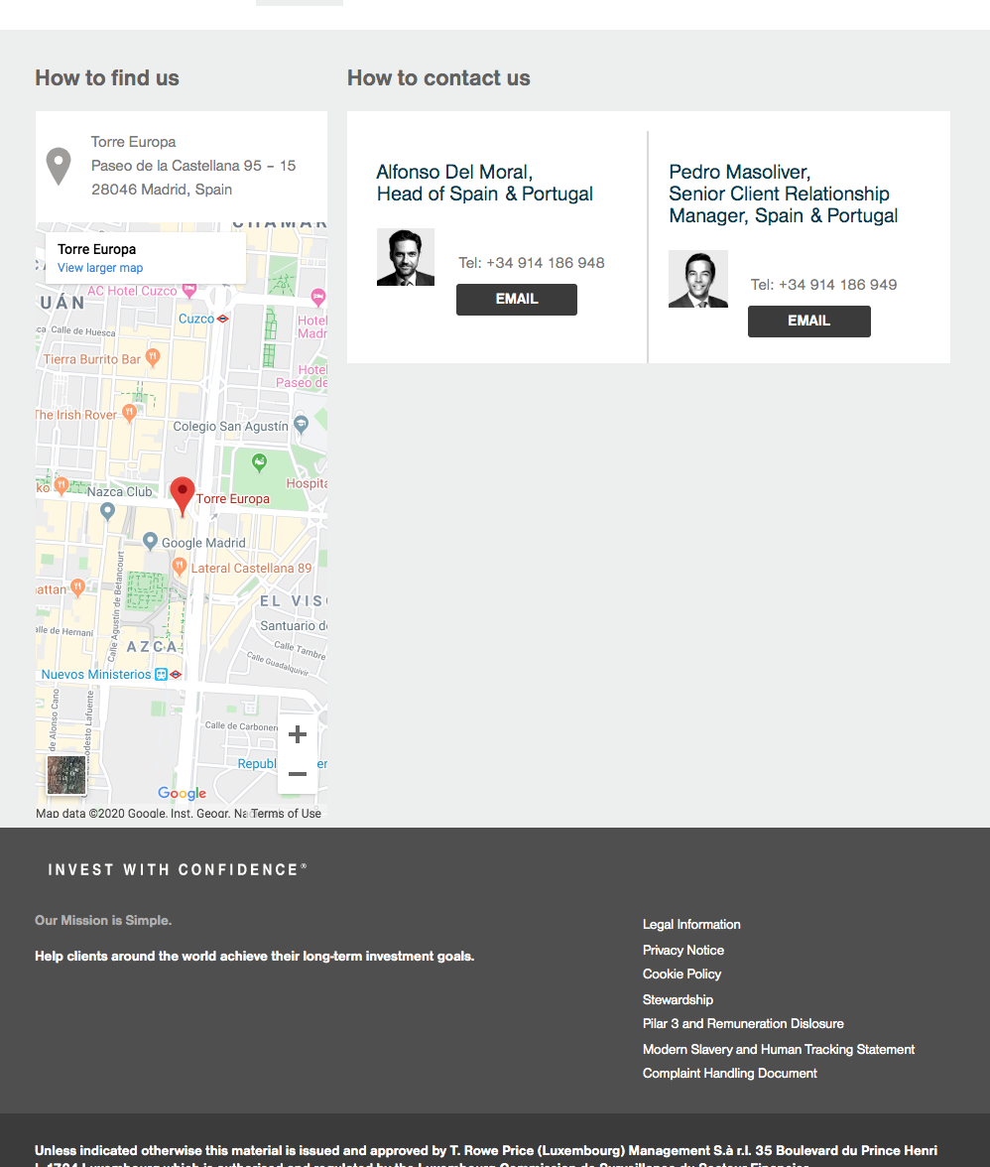
Non-compliant examples
Changes to be made:
Segmenting clearly by Fund Type
Attestation to determine investor type and jurisdiction
Contacts and Addresses of nearest local offices
Up to date documents (e.g. Annual Reports, Prospectus, KiiDs, Factsheets)
Up to date Price information and history
Local languages

Slide 10
QUESTIONS

